Slide 1
Prabhu Barathi
The Right way to DevOps with Terraform and Ansible
Cloud Developer Advocate | VMWare
@prabhu_b | beyondvirtual.io
March 2019

Slide 2
Agenda
Infrastructure as Code (IaC) Basics
Terraform ?
Why Terraform ? Terraform v/s Others
Sample code – Hello EC2 instances in AWS
Demo of sample app

Slide 3
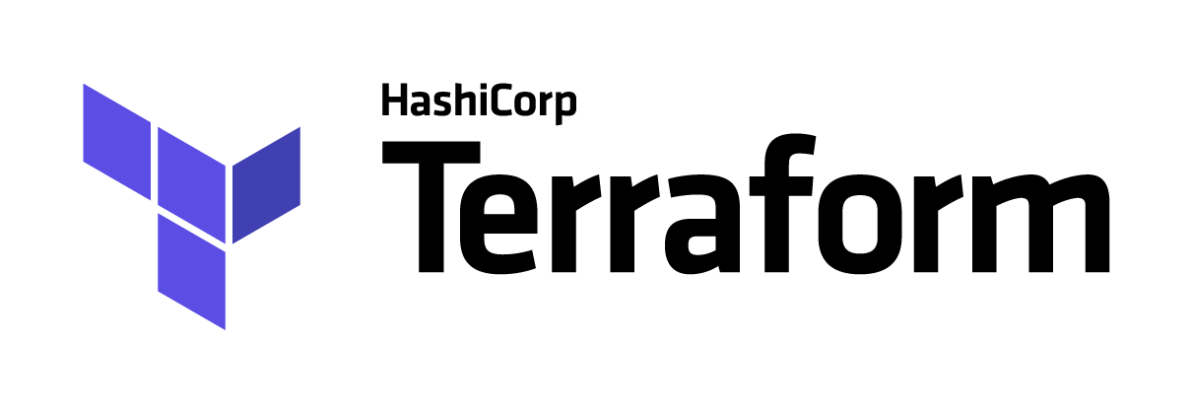
The Right Way – Use Both Terraform and Ansible
Provisioning of Cloud Infrastructure
Automation of Application Configuration

Slide 4
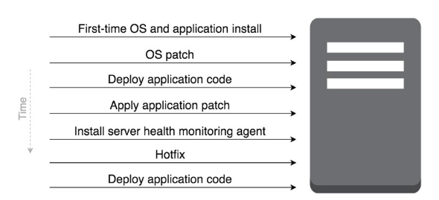
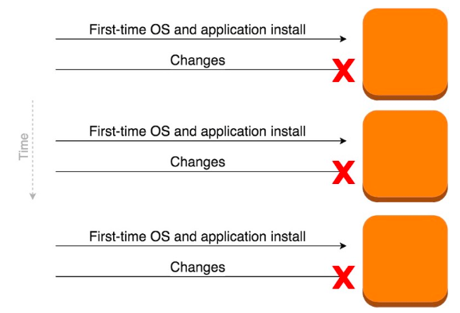
Immutable Infrastructure
Mutable Infrastructure
Err – what is this?
Provision new server every time/de-provision old ones
i.e. cue the cattle v/s pet analogy
In prod – helps with Blue/Green deployments
Rapid and iterative development ultimately.
Immutable Infrastructure

Slide 5
Some Basics first….
Chef/Puppet/Ansible – Configuration management
Automate process of installing, manage software “on” instances, VM’s etc.
Terraform/CloudFormation – Orchestration tools
Provision servers, infrastructure, leaving configuration to other tools like above
Procedural v/s Declarative:
Procedural – write code and define step-by-step
Declarative – specifies the end-state that is desired.
Client-server v/s Client-only architecture
Chef/Puppet/etc. > Client-server. Clients talk to central server for commands.
Terraform/CF – Client-only. Leverage API’s for orchestrating the requirements
Notes:
Procedural v/s Declarative :
Procedural – Connect to vCenter, Create a VM, Install Windows OS, Configure xyz
Declarative – Give me 2 VM’s with Windows OS and xyz

Slide 6
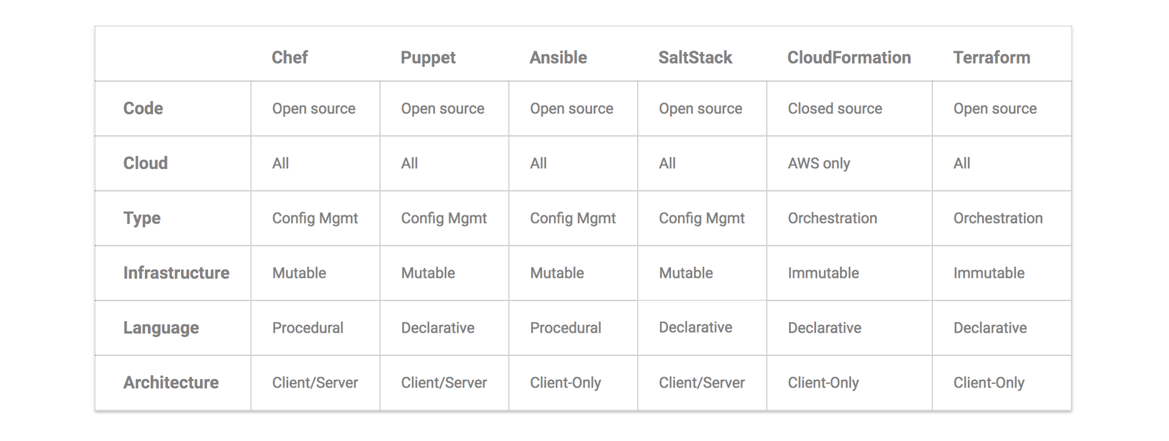
Putting it together - comparison

Slide 7
What is Terraform?
Part of Hashicorp DevOps Tool suite. Others are Vagrant, Packer, Vault, Consul, Nomad
Opensource tool to build, change, version, infrastructure across multiple providers
Opensource!
Multiple resources – AWS, vSphere, Openstack
DNS Entries, SaaS features etc.
Infrastructure as Code – describe end-state in a high-level syntax. Share and re-use
Execution plans – Planning step to generate execution plan.
Resource Graph – Graph of all resources, dependency map

Slide 8
Why Terraform ? Terraform v/s others
Single definition for multiple resources
Orchestrate instances across AWS, Azure and other cloud providers
Update DNS
Deploy on-prem vSphere or Openstack
Cloud Agnostic – CF is AWS only. Some see as restrictive
State Management - records the state of resources locally or remotely in a JSON file
Community involvement – high on developers radar

Slide 9
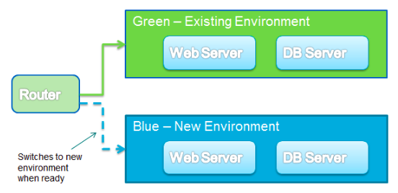
Benefits of using Terraform
Reusable Infrastructure as code > write once, use over and over
Version controlled, shared and collaboration
Maintains state information of what is deployed, history of deployments
Create, modify resources across multiple cloud providers – AWS, Azure, GCP, vSphere
Create identical Dev, QA, Staging etc.

Slide 10
Terraform Components
Constructs
Providers – responsible for understanding, executing the API, think AWS, cloud providers
Resources – instances, VM’s, VPC’s, Clusters etc.
Provisioners – take bare resource and boot-strap scripts or actions on resources.
Terraform Execution
Plan – terraform plan
Execute – terraform apply
Destroy – terraform destroy

Slide 11
Getting started with Terraform on MacOS
Install brew : https://brew.sh/
Install Terraform using brew : brew install terraform
Upgrading:
brew update
brew upgrade
Manual – Download binary from Hashicorp:
https://www.terraform.io/downloads.html
Install Atom, Visual Code or your favorite text editor. Next gen ones are better!

Slide 12
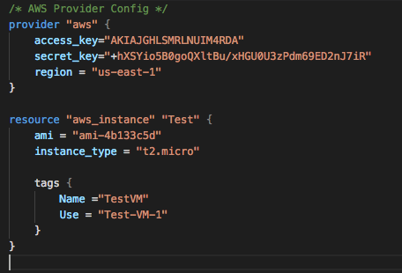
Terraform and AWS

Slide 13
Hello world…or hello EC2 instances
Provider = AWS
Resource = EC2 instance, type t2.micro and tag = TestVM-1
Simple script – but most likely you’ll have something more complicated
Four files :
something.tf > bulk of Terraform configuration
variables.tf > variable definition
Something.tfvars > values for the variables
e.g.
variables.tf contains subnet information and string defining it
something.tfvars contains the actual value for subnet
something.tfstate – state file for resources that have been provisioned

Slide 14
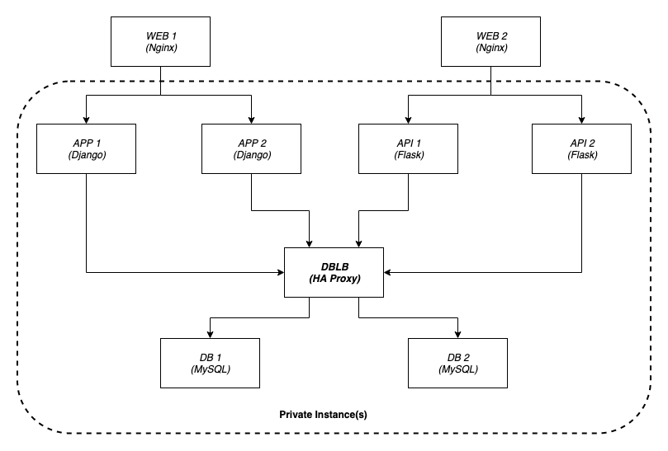
Demo – FitCycle App
GitHub Repo - github.com/vmwarecloudadvocacy/vcs-fitcycle-deployer

Slide 15
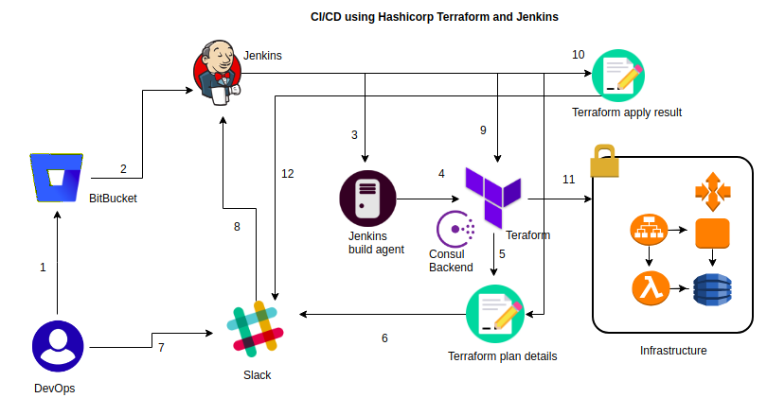
How does this look end-to-end with a pipeline?

Slide 16

@prabhubarathi | vmwarecloudadvocacy
@prabhu_b
www.Beyondvirtual.io

